Slide 1
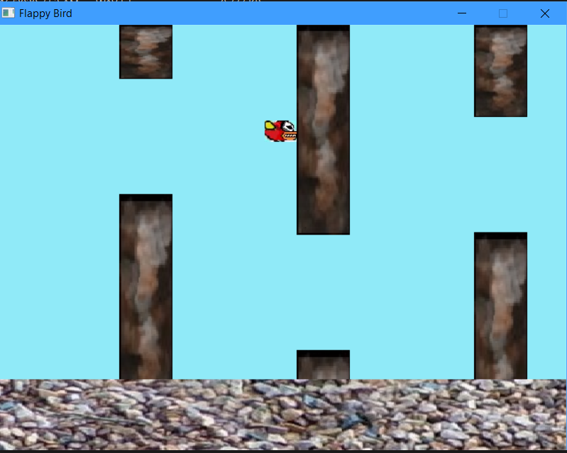
Flappy bird
Presented by: Rajesh Neupane (076BCT055)
Rahul Jha (076BCT053)
Pratik Dahal (076BCT051)
Rishav Bhattarai (076BCT058)

Slide 2
introduction
This C mini project is about a mini game, named as Flappy bird. Although being a small game, it’s designing and programming required a lot of C features, since its coded in C language. Structures, pointers, basic header files and libraries for gaming prospects are used here rapidly.
Why C?
C is a simple, machine independent, portable and mid-level programming language.
It’s a structured programming language rich in libraries,
Its faster,
It has some great features like pointers, recursion, etc. facilitating in memory management.

Slide 3
objective
So, a game like this with an ‘objective’ sounds cringe. But, necessity is the mother of invention, right? Since slow internet is inevitable anywhere in world, chrome browser invented the famous dinosaur game that we all have surely played at any stage, and have got bored too or furied by its game over mode. So, we have modelled a similar concept and brought this game, Flappy bird to you, so if you have a slow internet and also don’t want to see any dinosaur, we have an alternative for you. Just hang around and fly with our flappy bird infinitely.

Slide 4
Salient featured of Flappy bird
You can fly your bird with a click(gap button) and overpass the obstacles(i.e. walls).
You can give your bird a push in either front or back direction by clicking side buttons.
You can play this game for infinite time, i.e. there’s no time limitation or ‘game over’ thing here. So, you can fly and fly and fly with your bird forever.
Simple form of graphics are used to reduce loading time.
It can enhance your reacting and focusing skills.

Slide 5
scope
This game is developed just as a model and simulation. If it is created in more advanced manner, it can be a good alternative for fun and time pass. It can be used in web browsers or other apps(requiring an internet connection to run) when the connectivity is low or absent.

Slide 6
at the end…
Although this game looks so simple, it required a lot of hardwork and creative ideas to build it. Uses of so many in-built functions and other features of C were required to give this game’s vision a development.

Slide 7
End of slide. Press esc to exit.

